Slide 1
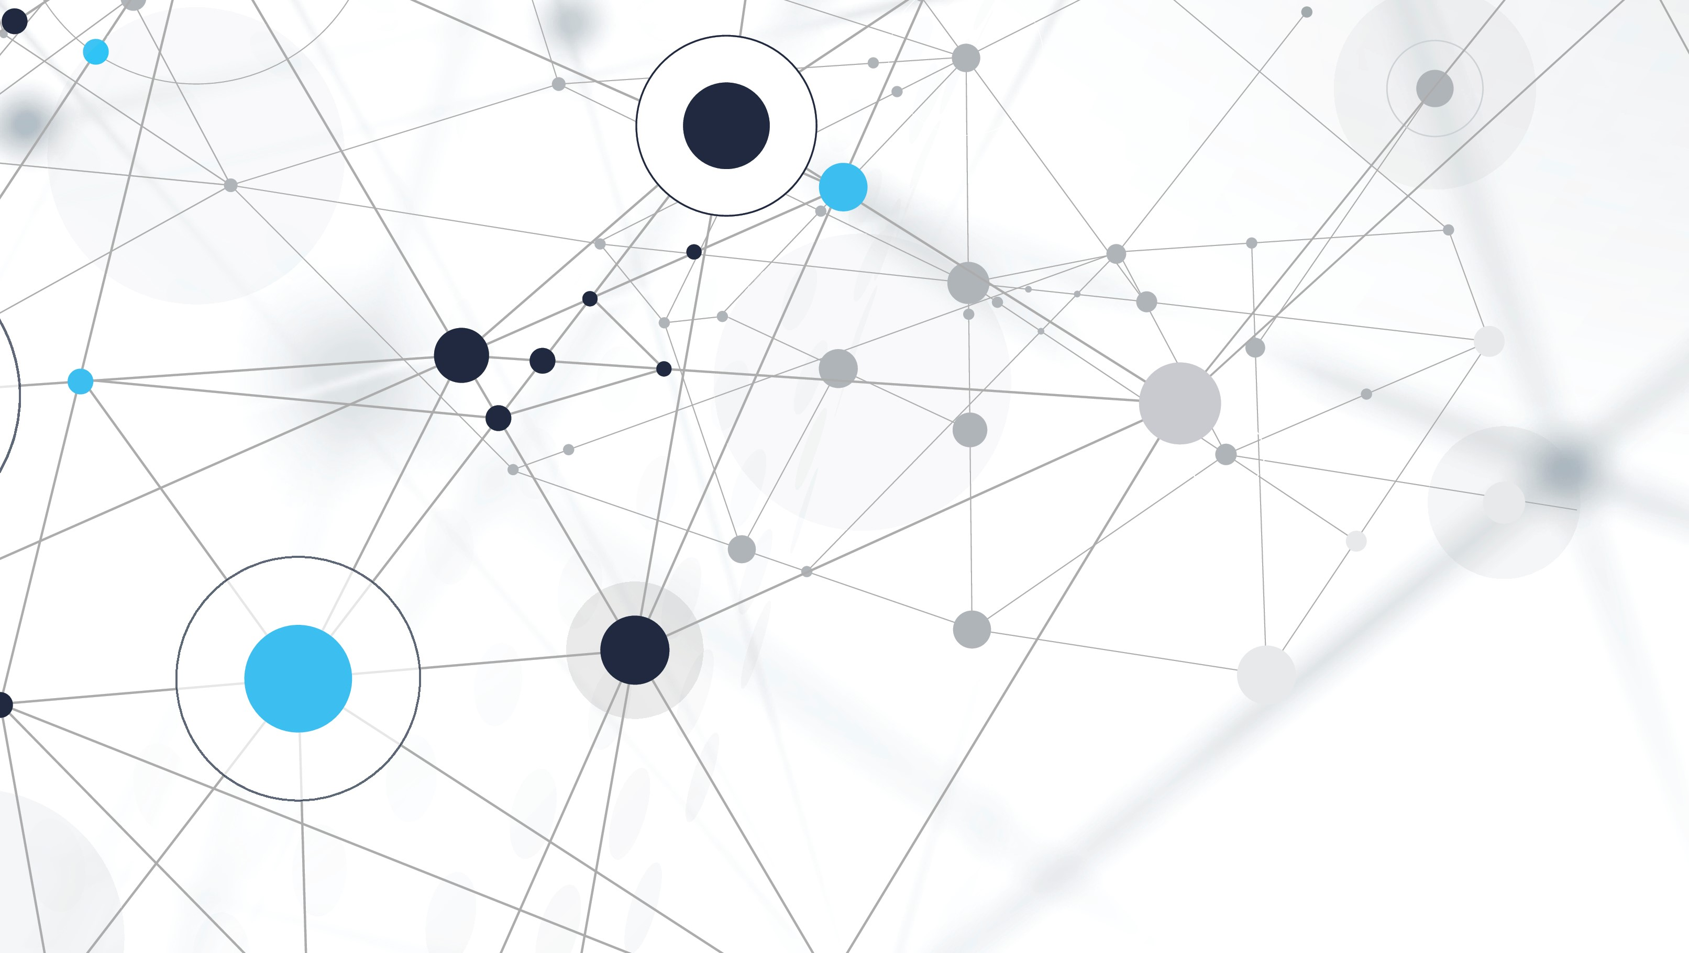
Enable telemetry monitoring in .net8 with Grafana Observability stack
Muhammad Kashif Javed

Slide 2
What is open-telemetry
Open-Telemetry is an open-source project that provides a set of tools and standards for collecting and managing telemetry (logs, traces & metrics) data. Telemetry data is used to monitor and observe the performance and behaviour of applications.
It offers a unified approach to observability and to ensure interoperability across different systems and tools. It provides libraries and APIs for instrumenting code, collecting data, and exporting it to various backends, helping developers and operators to gain insights into their applications' performance and troubleshoot issues effectively.

Slide 3
Key benefits of using open-telemetry
Unified Observability
Comprehensive Monitoring Solution
Ease of Integration and Use
Enhanced Troubleshooting and Analysis
Scalability and Flexibility

Slide 4
Unified Observability
Metrics (Prometheus): Open-Telemetry can collect detailed metrics from your .NET applications, such as request counts, latencies, and error rates. Prometheus, a powerful time-series database, can store and query these metrics efficiently.
Logs (Loki): Open-Telemetry can also handle logs by integrating with Loki, which is designed to work seamlessly with Prometheus. Loki indexes logs in a way that’s optimized for querying alongside metrics.
Traces (Open-Telemetry + Grafana): Open-Telemetry provides distributed tracing capabilities, capturing end-to-end request flows through your .NET application. Grafana can visualize these traces, providing insights into performance bottlenecks and dependencies.

Slide 5
Comprehensive Monitoring Solution
Prometheus: Gathers and stores metrics data. It supports powerful querying with PromQL and integrates well with Grafana for visualizations.
Logs (Loki): Open-Telemetry can also handle logs by integrating with Loki, which is designed to work seamlessly with Prometheus. Loki indexes logs in a way that’s optimized for querying alongside metrics.
Grafana: Serves as the visualization layer for both metrics and logs. It enables you to create dashboards that combine data from Prometheus and Loki, providing a holistic view of your application's health and performance.

Slide 6
Ease of Integration and Use
Standardization: OpenTelemetry provides a standard way to instrument your .NET code, which simplifies the integration process with Prometheus, Loki, and Grafana.
Rich Ecosystem: Leveraging these tools together allows you to use their full capabilities, from metrics collection and querying to log aggregation and visualization, without needing to develop custom solutions.

Slide 7
Enhanced Troubleshooting and Analysis
Correlation of Data: By integrating logs, metrics, and traces, you can correlate data from different sources. For example, you can identify a spike in errors in Prometheus metrics, then use Loki to find related logs, and finally use traces to understand the end-to-end flow leading to the issue
Root Cause Analysis: Detailed traces and logs, combined with metrics, provide deeper insights into performance problems, helping you pinpoint the root cause more effectively.

Slide 8
Scalability and Flexibility
Scalable Metrics Collection: Prometheus scales well with high cardinality metrics and large volumes of data, making it suitable for large .NET applications.
Efficient Log Management: Loki is designed to handle large volumes of logs efficiently, and it integrates well with Prometheus and Grafana for a seamless observability experience.
Customizable Dashboards: Grafana offers extensive customization options for creating dashboards, allowing you to tailor the visualizations to your specific needs and preferences.

Slide 9
Observability Setup Requirements for .net8
Nuget Packages
Registering required services.
Adding required configurations in appsettings.json
Add Dockerfile
Setup Docker-compose
Register required images and dependency (Loki, Prometheus, Promtail, Open-telemetry) configs.

Slide 10
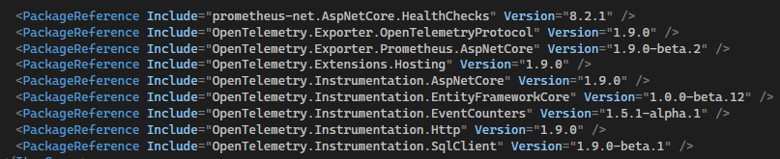
Nuget packages

Slide 11
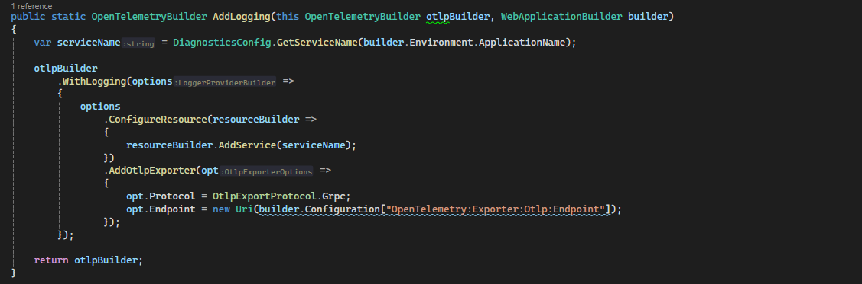
Registering required services
Logging setup

Slide 12
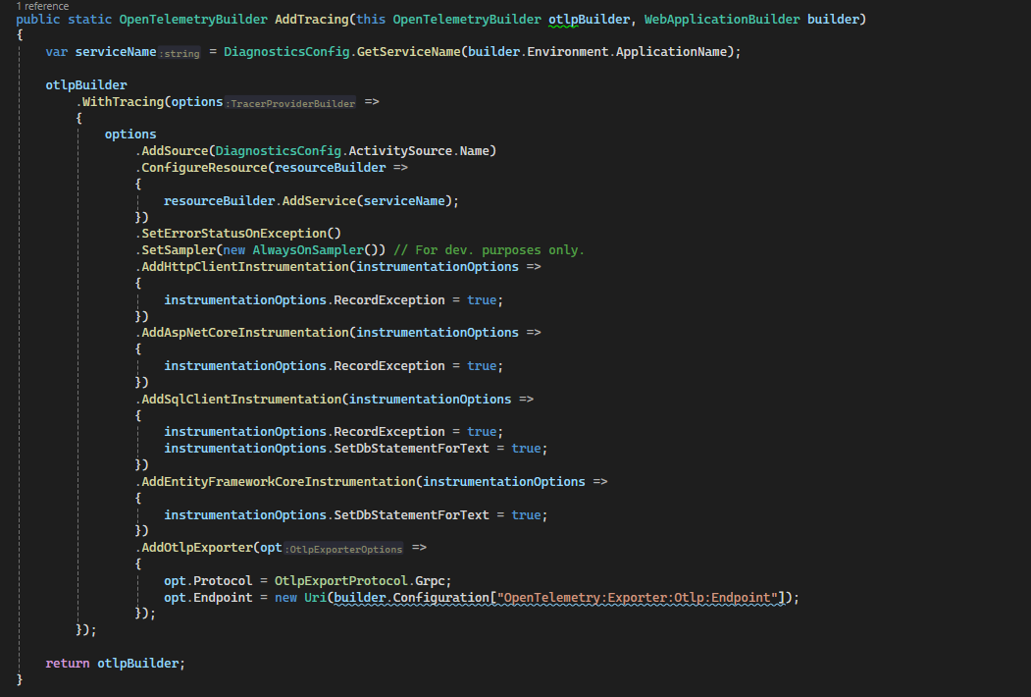
Registering required services
Tracing setup

Slide 13
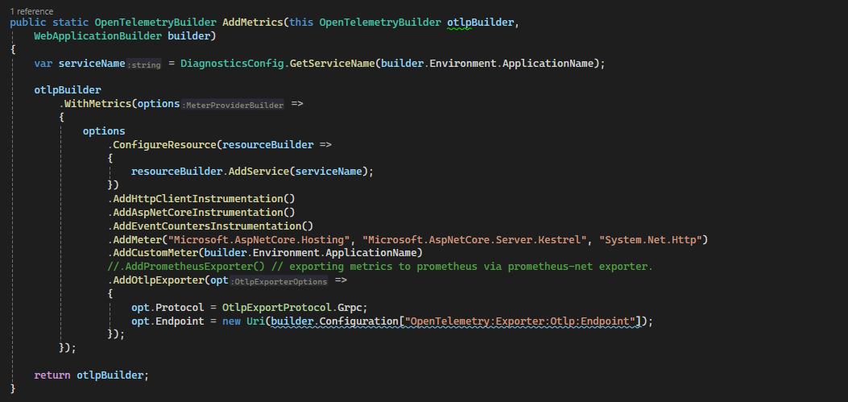
Registering required services
Metrics setup

Slide 14
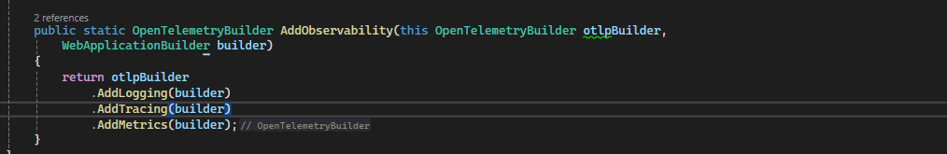

Finally adding All setup to program.cs
Registering setup to services in program.cs

Slide 15
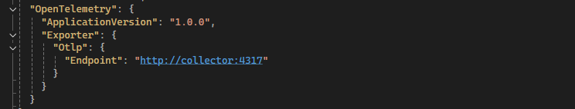
Adding configuration in appsettings

Slide 16
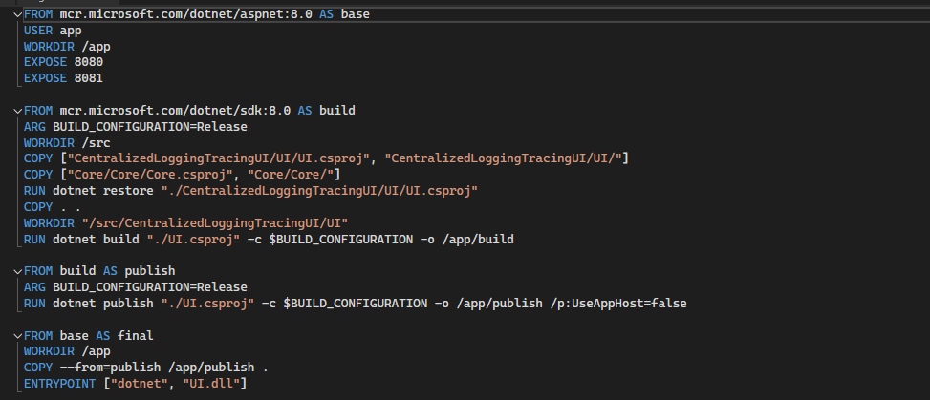
Dockerfile

Slide 17
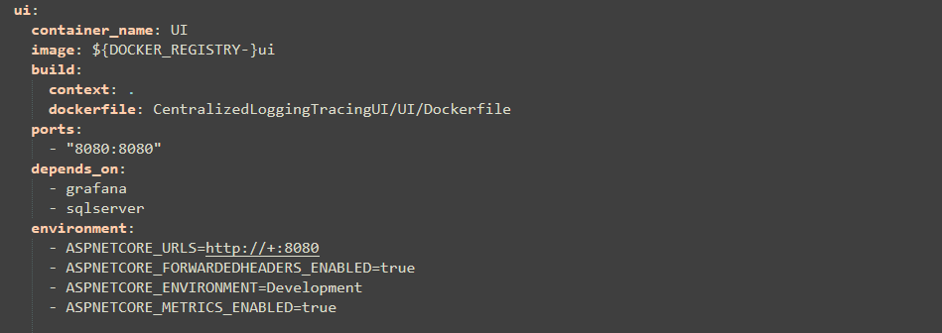
Docker-compose Setup
Application setup

Slide 18
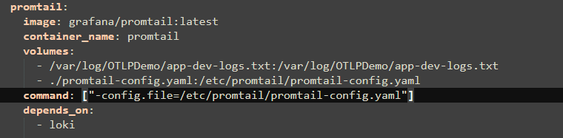
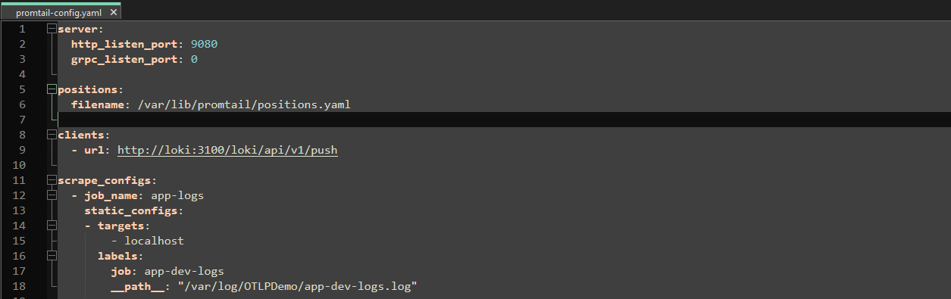
Docker-compose Setup
Promtail setup

Slide 19
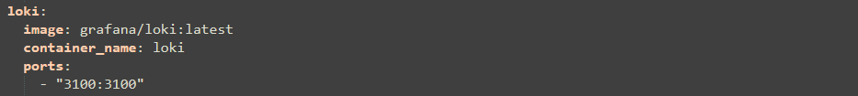
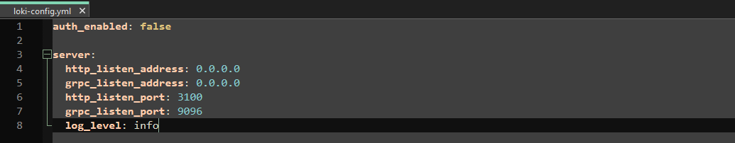
Docker-compose Setup
Loki setup

Slide 20
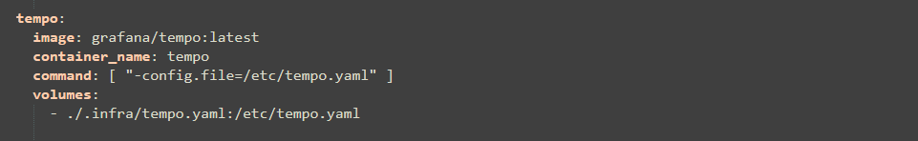
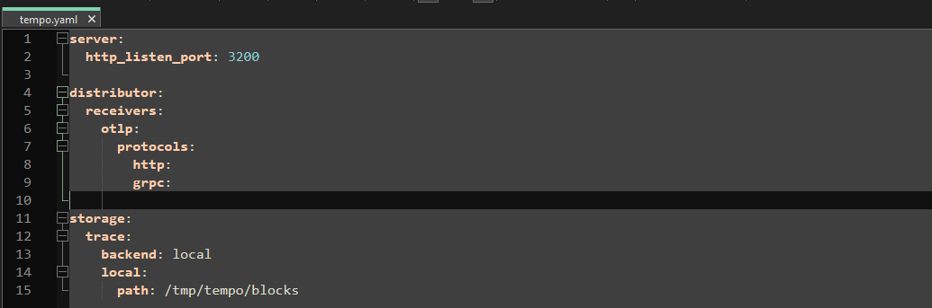
Docker-compose Setup
Tempo setup

Slide 21
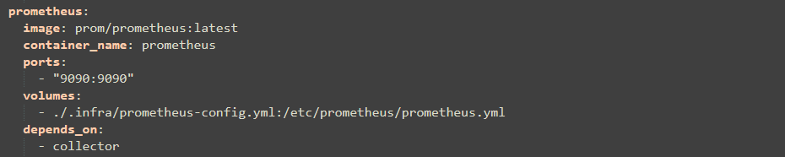
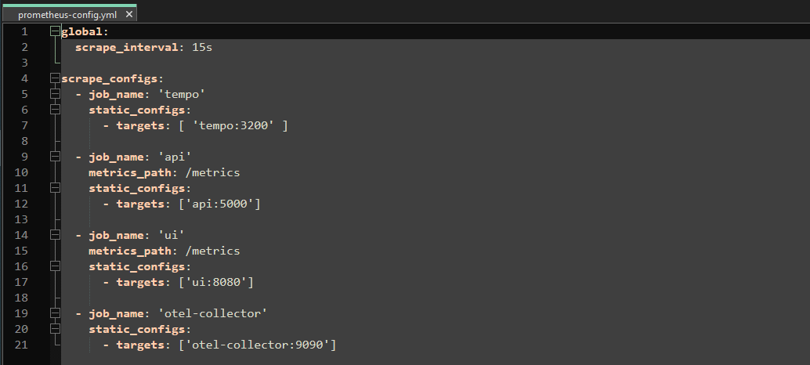
Docker-compose Setup
Prometheus setup

Slide 22
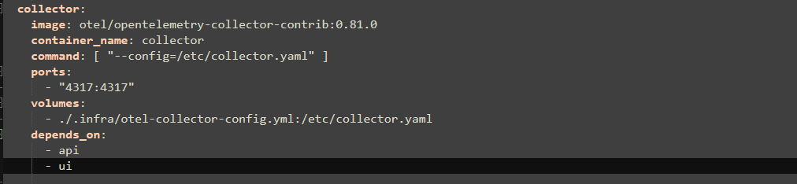
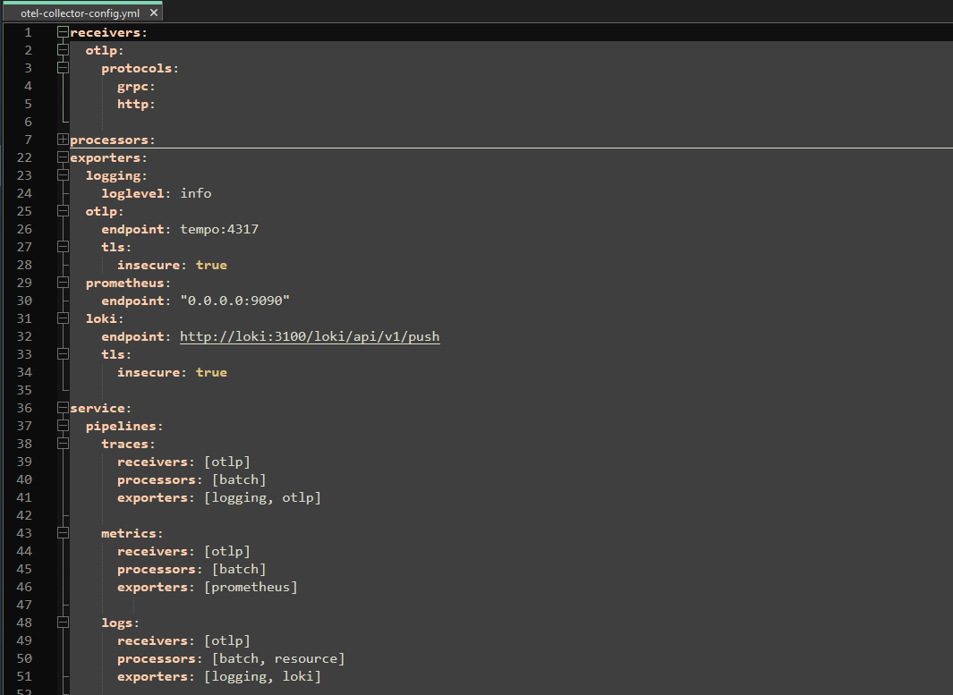
Docker-compose Setup
Open-Telemetry collector setup

Slide 23
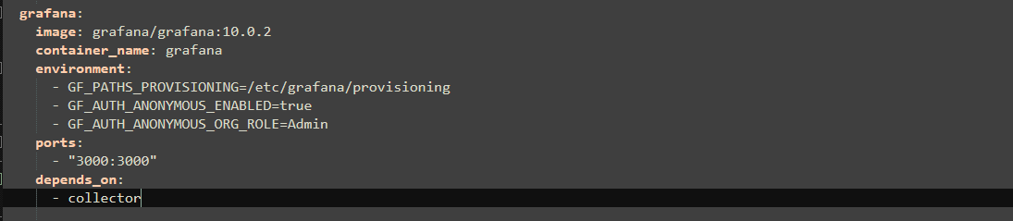
Docker-compose Setup
Grafana setup

Slide 24
References
https://dev.to/kim-ch/observability-net-opentelemetry-collector-25g1
https://dev.to/dbolotov/observability-with-grafana-cloud-and-opentelemetry-in-net-microservices-448c
https://learn.microsoft.com/en-us/dotnet/core/diagnostics/observability-prgrja-example
https://www.youtube.com/playlist?list=PLdvI3YlPDGgdFG2mlXOy403V0J3MhRHeE

